Slide 1

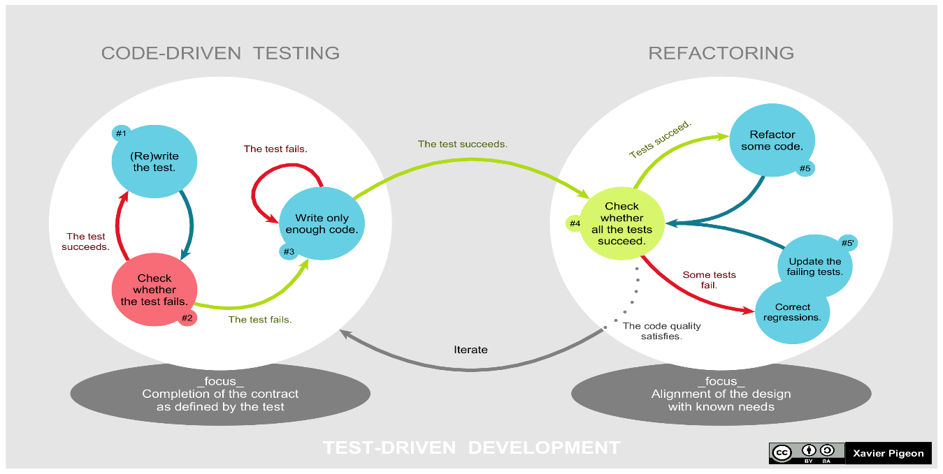
Agile Software Development
Topic: Test Driven Development
Dr. Nikhil Govil
Associate Professor, Program Coordinator – B.Tech. (CSE), Dept. of CEA

Slide 2

Test Driven Development (TDD)
Test Driven Development (TDD) is software development approach in which test cases are developed to specify and validate what the code will do.
In simple terms, test cases for each functionality are created and tested first and if the test fails then the new code is written in order to pass the test and making code simple and bug-free.
Test-Driven Development starts with designing and developing tests for every small functionality of an application.
TDD instructs developers to write new code only if an automated test has failed. This avoids duplication of code.

Slide 3
Test Driven Development Process
Add a Test
Run all tests and see if the new one fails
Write the code
Run tests
Refactor code

Slide 4
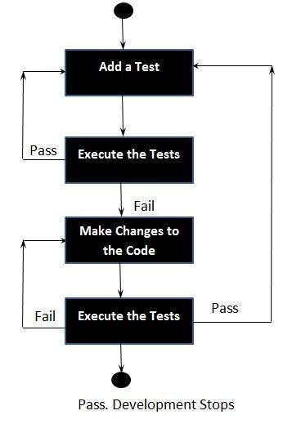
Test Driven Development Process

Slide 5
Test Driven Development Process
Phase 1 – Add a test
In test - driven development, each new feature begins with writing a test. Write a test that defines a function or improvements of a function, which should be very brief.
To write a test, the developer must clearly understand the feature's specification and requirements. One can make use of use cases and user stories to cover the requirements.

Slide 6
Test Driven Development Process
Phase 2 – Run all tests and see if the new one fails
This validates that the test is working correctly, shows that the new test does not pass without requiring new code because the required behavior already exists.
The new test should fail for the expected reason. This step increases the developer's confidence in the new test.

Slide 7
Test Driven Development Process
Phase 3 – Write the code
The next step is to write some code that causes the test to pass. The new code written at this stage may not be perfect. That is acceptable because it will be improved in Phase 5.
At this point, the only purpose of the written code is to pass the test. The programmer must not write code that is beyond the functionality that the test checks.

Slide 8
Test Driven Development Process
Phase 4 – Run tests
If all test cases now pass, the programmer can be confident that the new code meets the test requirements, and does not break or degrade any existing features.
If they do not, the new code must be adjusted until they do.

Slide 9
Test Driven Development Process
Phase 5 – Refactor code
Typically, refactoring applies a series of standardized basic micro-refactorings, each of which is (usually) a tiny change in a computer program's source code that either preserves the behavior of the software, or at least does not modify its conformance to functional requirements.

Slide 10
Benefits of Test Driven Development
Code Coverage is good.
Parallel Regression Testing is Performed.
Simplified Debugging.
System Documentation as Test Cases.

Slide 11
Drawbacks of Test Driven Development
Complex to convert requirements to test cases.
Lot many testing cycles are involved.
Modification to existing code may be tough.
Use of TDD tools is the game of experts only.

Slide 12
References
Ken Schawber & Mike Beedle, Agile Software Development with Scrum, Pearson, 2008.
Robert C. Martin, Agile Software Development, Principles, Patterns and Practices, Prentice Hall,2002.
Lisa Crispin & Janet Gregory, Agile Testing: A Practical Guide for Testers and Agile Teams, Addison Wesley, 2008.
Alistair Cockburn, Agile Software Development: The Cooperative Game, Addison Wesley, 2006.

Slide 13


